Slide 1
Riddles
5th & 6th Class

Slide 2
Elina O’Callaghan’s
Riddle
I am something people love or hate. I change peoples appearances and thoughts. If a person takes care of themselves I will go up even higher. To some people I will fool them. To others I am a mystery. Some people might want to try and hide me but I will show. No matter how hard people try I will never go down. What am I?
Answer = Age

Slide 3
What is white when its dirty ?
A Blackboard
By Emma ONeill

Slide 4
What always runs but never walks, often murmurs, never talks, has a bed but never sleeps, has a mouth but never eats?
A river
By Ellie Shortall

Slide 5
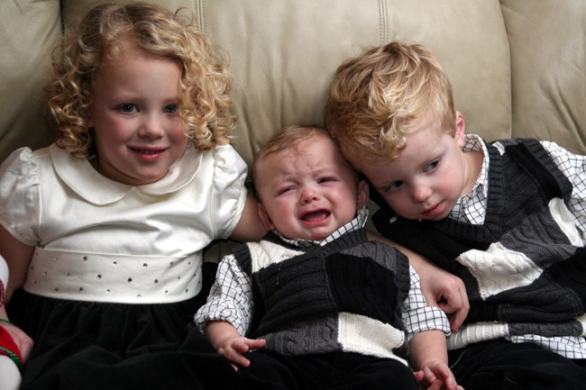
Angela's mum has 3 children snap,crackle and what?
Angela
By John

Slide 6
+
=
A needle
What has one eye but cannot see?
By Rowan

Slide 7
?
60 pounds
40 pounds
A Hole
A barrel of water weighs 60 pounds. Someone put something in it and now it weighs 40 pounds. What did he put in it?
By Ciaran

Slide 8
I am always hungry and will die if not fed ,but whatever I touch will soon turn red. What am I?
Fire
By Holly

Slide 9
By
Meadbh
If you drop me I’m sure to crack, but give me a smile and I’ll always smile back. What am I?
A mirror

Slide 10
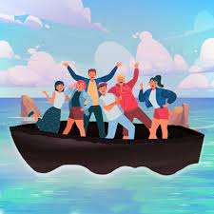
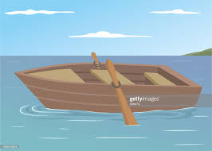
All the people on the boat are married.
You see a boat filled with people, yet there isn’t a single person on board.How is that possible?
By Hilary Hannan

Slide 11
I sing with no voice and I whistle with no breath. What am I?
A kettle!
By Ciara C

Slide 12
What can’t talk but will reply when spoken to?
???
An echo
By Chloe Chawke.

Slide 13
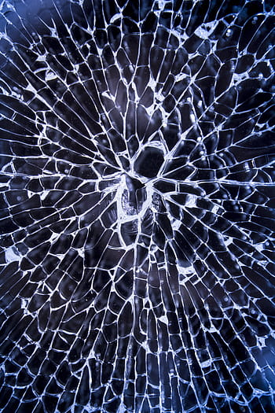
- -
What is so fragile that if you say its name it will break?
By Diarmuid
Silence

Slide 14
I have a tail and a head but no body. What am I?
A coin.
By Oran

Slide 15
I follow you all the time and copy your every move, but you can’t touch me or catch me. What am I?
Your Shadow
By David Tierney

Slide 16
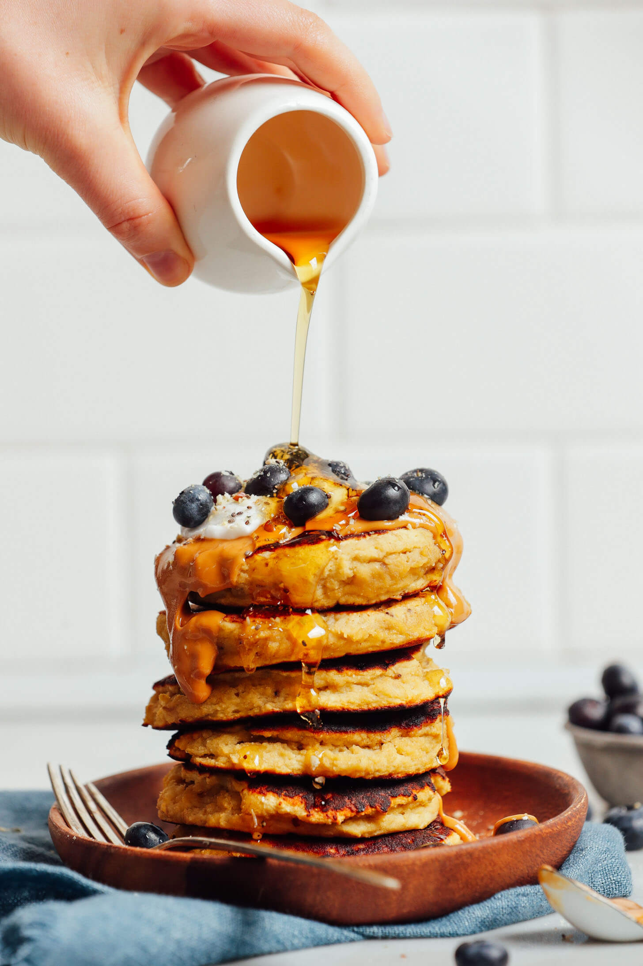
What two things can you never have for breakfast?
by Katie
Lunch & Dinner

Slide 17
What has 13 hearts but no other organs
????? ?????????? ????????????????????? ????????? ?????????????
By Ťommy
A deck of cards

Slide 18
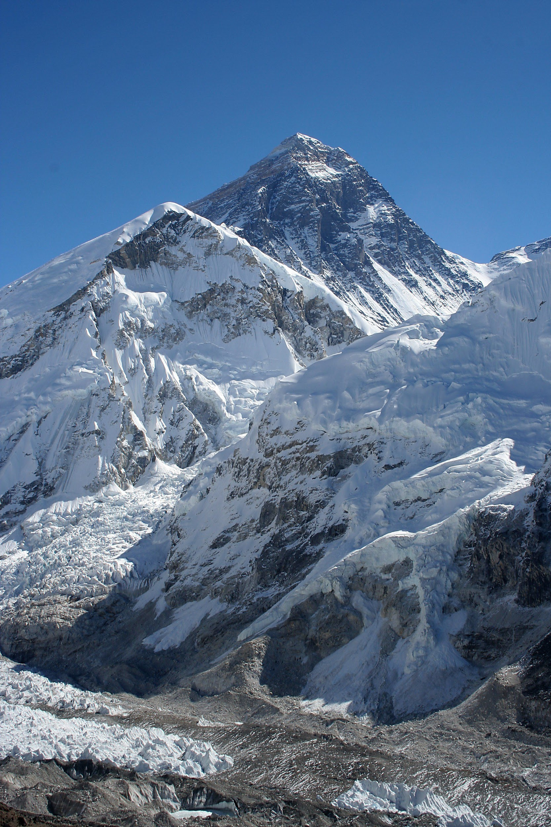
By Shane Wharton
Mount Everest
Before Mount Everest was discovered what was the highest mountain on earth?
Mount Everest
Mount Everest

Slide 19
II go all around the world I never leave the corner.What am I?
A stamp
by riain

Slide 20
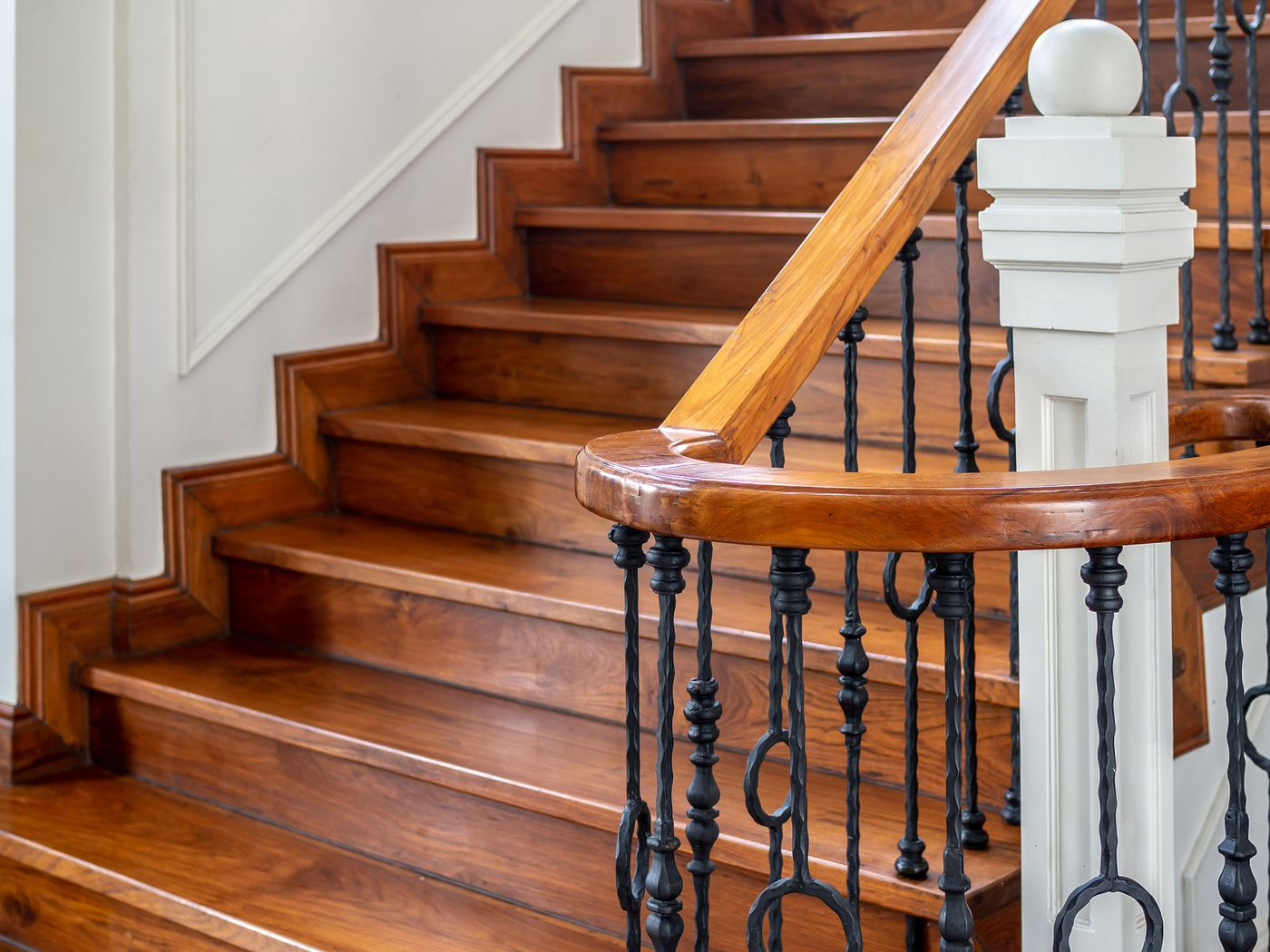
There's a one story house in which everything is yellow.Yellow walls,yellow doors,yellow furniture.What colour are the stairs?
There is no stairs because its a one story house!
By Abbie Halpin

Slide 21
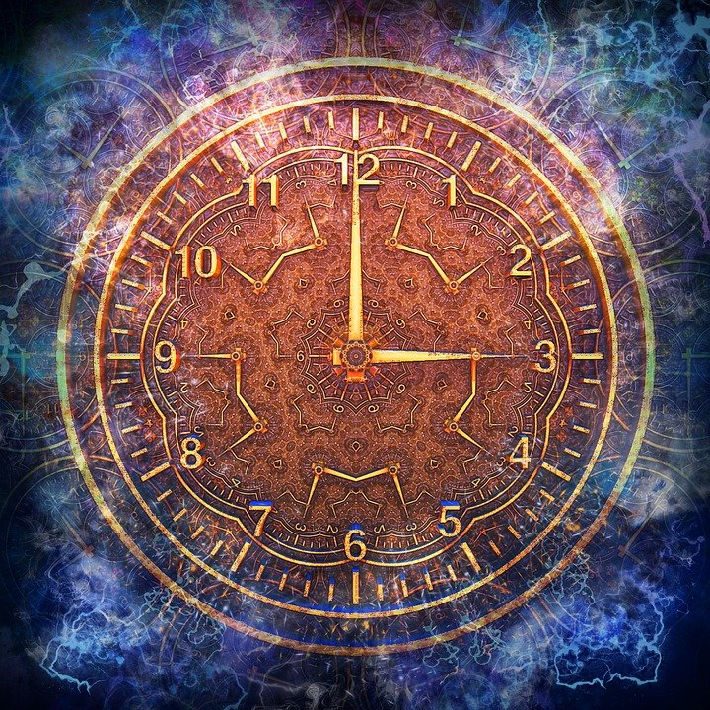
What comes once in a minute twice in a moment but never in a thousand years?
The letter “M”
By Emma Teefy
By Emma Teefy

Slide 22
I have cities but no houses,
Mountains without trees,
Water with no fish,
now riddle me this
What am I?
A map
By Evelyn

Slide 23
The more there is the less you see what is it?
By Melissa
Darkness

Slide 24
What has 88 keys but no door?
A Piano
By Ava

Slide 25
There were three people in a car yet there were 2 fathers and 2 sons. How can this be?
By Olivia Cahill
A grandfather, his son and grandson are travelling together.
The Grandfather’s son doubles up as the father of the grandson. As a results 2 of the men in the car are fathers and 2 are sons.
Notes:
A grandfather, his son and grandson are travelling together. The Grandfather’s son doubles up as the father of the grandson. As a results 2 of the men in the car are fathers and 2 are sons.

Slide 26
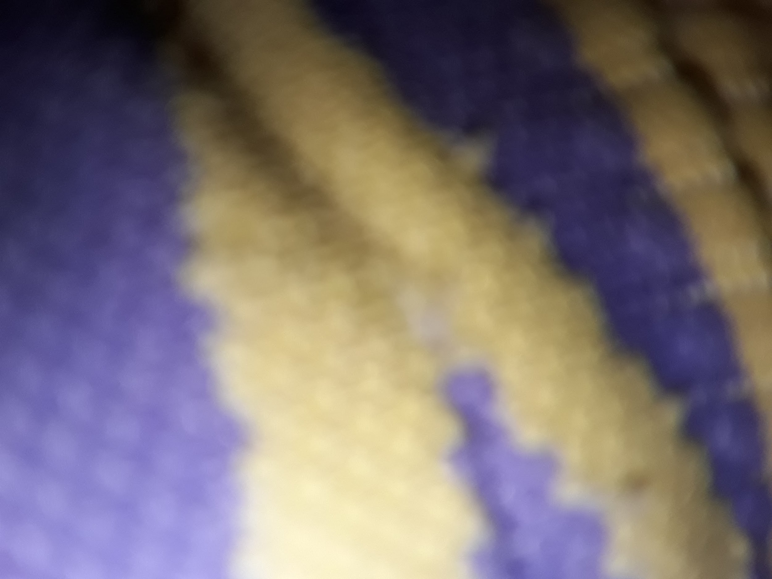
What has a ring but no finger?
A mobile phone
by Daniel

Slide 27
What goes Z to A?
A Zebra
By Emma Hennessy

Slide 28
People make me,save me,change me,raise me.
What am I ?
By Grace
Money 💰

Slide 29
Which question can you never ever answer yes to?
Are you asleep?
By Cameron

Slide 30
Riddle by Aaron
WHAT HAS A HEAD,

Slide 31
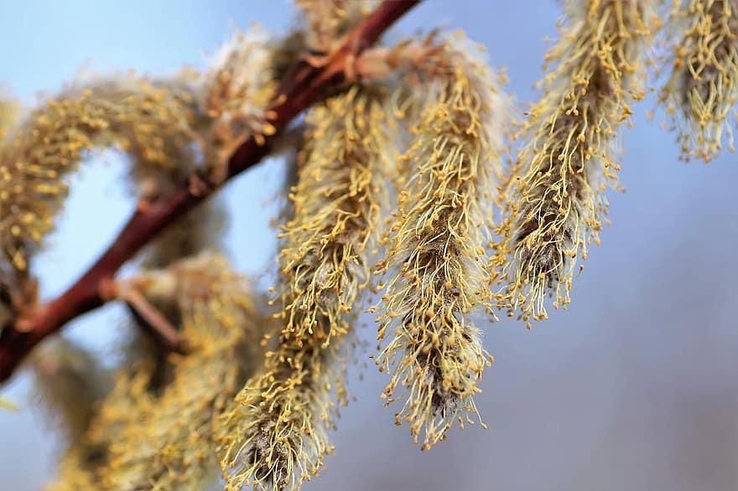
WHAT HAS TAILS

Slide 32
IS BROWN IN COLOUR

Slide 33
& HAS NO LEGS?
A PENNY

